Slide 1
Design for Testability
Theory and Practice
Professors Adit Singh and Vishwani Agrawal
Electrical and Computer Engineering
Auburn University, Auburn, AL 36849, USA
Notes:
The slide guide is available in the following file:
slidesV4.3.ppt: PowerPoint 2000 format. Viewable also
with PowerPoint ’97.

Slide 2
Presenters
Adit D. Singh is James B. Davis Professor of Electrical & Computer Engineering at Auburn University, where he directs the VLSI Design & Test Laboratory. Earlier he has held faculty positions at the University of Massachusetts in Amherst, and Virginia Tech in Blacksburg. His research interests are in VLSI design, test, reliability and fault tolerance; he has published over a 100 papers in these areas and holds international patents that have been licensed to industry. He has also served as Chair/Co-Chair or Program Chair of over a dozen IEEE international conferences and workshops. Over the years he has taught approximately 50 short courses in-house for companies including IBM, National Semiconductor, TI, AMD, Advantest, Digital, Bell Labs and Sandia Labs, also at IEEE technical meetings, and through university extension programs. Dr. Singh currently serves on the Executive Committee of the IEEE Computer Society’s Technical Activities Board, on the Editorial Board of IEEE Design and Test, and is Vice Chair of the IEEE Test Technology Technical Council. He is a Fellow of IEEE and a Golden Core Member of the IEEE Computer Society.
Vishwani D. Agrawal is James J. Danaher Professor of Electrical &Computer Engineering at Auburn University, Auburn, Alabama, USA. He has over thirty years of industry and university experience, working at Bell Labs, Rutgers University, TRW, IIT in Delhi, EG&G, and ATI. His areas of research include VLSI testing, low-power design, and microwave antennas. He has published over 250 papers, holds thirteen U.S. patents and has co-authored 5 books including Essentials of Electronic Testing for Digital, Memory and Mixed-Signal VLSI Circuits with Michael Bushnell at Rutgers. He is the founder and Editor -in-Chief of the Journal of Electronic Testing: Theory and Applications, was a past Editor -in-Chief of the IEEE Design & Test of Computers magazine, and is the Founder Editor of the Frontiers in Electronic Testing Book Series. Dr. Agrawal is a co-founder of the International Conference on VLSI Design, and the International Workshops on VLSI Design and Test, held annually in India. He served on the Board of Governors of the IEEE Computer Society in 1989 and 1990,and, in 1994, chaired the Fellow Selection Committee of that Society. He has received seven Best Paper Awards, the Harry H. Goode Memorial Award of the IEEE Computer Society, and the Distinguished Alumnus Award of the University of Illinois at Urbana-Champaign. Dr. Agrawal is a Fellow of the IETE-India, a Fellow of the IEEE and a Fellow of the ACM. He has served on the advisory boards of the ECE Departments at University of Illinois, New Jersey Institute of Technology, and the City College of the City University of New York.

Slide 3
Design for Testability – Theory and Practice
Three-Day Intensive Course
Hyderabad, July 27-29, 2006
Day 1
AM Introduction Singh
Basics of testing Singh
Fault models Singh
PM Logic simulation Agrawal
Fault simulation Agrawal
Testability measures Agrawal
Day 2
AM Combinational ATPG Agrawal
Sequential ATPG Agrawal
PM Delay test Singh
IDDQ testing, reliability Singh
Day 3
AM Memory test Agrawal
Scan, boundary scan Agrawal
PM BIST Singh
Test compression Singh

Slide 4
Books on Testing
M. Abramovici, M. A. Breuer and A. D. Friedman, Digital Systems Testing and Testable Design, Piscataway, New Jersey: IEEE Press, 1994, revised printing.
M. L. Bushnell and V. D. Agrawal, Essentials of Electronic Testing for Digital, Memory and Mixed-Signal VLSI Circuits, Boston: Springer, 2000. Appendix C, pp. 621 - 629, lists more books on testing. Also see http://www.eng.auburn.edu/~vagrawal/BOOK/books.html
D. Gizopoulos, editor, Advances in Electronic Testing: Challenges and Methodologies, Springer, 2005, volume 27 in Frontiers in Electronic Testing Book Series.
N. K. Jha and S. K. Gupta, Testing of Digital Systems, London, United Kingdom: Cambridge University Press, 2002.
L.-T. Wang, C.-W. Wu and X. Wen, editors, VLSI Test Principles and Architectures: Design for Testability, Elsevier Science, 2006.

Slide 5
Topics
Introduction
The VLSI Test Process
Test Basics
Stuck-at faults
Test generation for combinational circuits
Automatic Test Pattern Generation (ATPG)
Fault Simulation and Grading
Test Generation Systems
Sequential ATPG
Scan and boundary scan
Design for testability
Timing and Delay Tests
IDDQ Current Testing
Reliability Screens for burn-in minimization
Memory Testing
Built in self-test (BIST)
Test compression
Memory BIST
IEEE 1149 Boundary Scan
Conclusion
Books on testing
Notes:
View it as a slide show first. It will highlight important aspects of your presentation, and give you an example of a presentation that lives up to ITC presentation standards and guidelines.
Virus checker: When we created this presentation guide it contained no known viruses. This file was checked by McAfee VShield 4.x software before being distributed to authors. You should use a good, up to date virus checker on this file, and any other file you import from an outside source. Make sure your virus checker’s data files are up to date, too. Keep in mind: the version of this file you are reading may be different from the version we checked!
Confidentiality: We respect your copyright, and do not distribute your presentation before the conference. However, we cannot promise strict confidentiality of your presentation before the conference, because others have read access to our FTP sites. Do not include confidential information in your presentation.
Test Slide: A test slide is included as a “hidden slide” after the end of this presentation. If you want to do a trial projection, ensure that your projector projects the entire slide, and that aspect ratios are correct. We will use the same test slide at the conference for setup of our projection equipment.

Slide 6
Introduction
Many integrated circuits contain fabrication defects upon manufacture
Die yields may only be 20-50% for high end circuits
ICs must be carefully tested to screen out faulty parts before integration in systems
Latent faults that cause early life failure must also be screened out through “burn-in” stress tests
Notes:
View it as a slide show first. It will highlight important aspects of your presentation, and give you an example of a presentation that lives up to ITC presentation standards and guidelines.
Virus checker: When we created this presentation guide it contained no known viruses. This file was checked by McAfee VShield 4.x software before being distributed to authors. You should use a good, up to date virus checker on this file, and any other file you import from an outside source. Make sure your virus checker’s data files are up to date, too. Keep in mind: the version of this file you are reading may be different from the version we checked!
Confidentiality: We respect your copyright, and do not distribute your presentation before the conference. However, we cannot promise strict confidentiality of your presentation before the conference, because others have read access to our FTP sites. Do not include confidential information in your presentation.
Test Slide: A test slide is included as a “hidden slide” after the end of this presentation. If you want to do a trial projection, ensure that your projector projects the entire slide, and that aspect ratios are correct. We will use the same test slide at the conference for setup of our projection equipment.

Slide 7
IC Testing is a Difficult Problem
Need 2³ = 8 input patterns to exhaustively test a 3-input NAND
2^{N} tests needed for N-input circuit
Many ICs have > 100 inputs
Only a very few input combinations can be applied in practice
3-input NAND
2¹⁰⁰ = 1.27 x 10³⁰
Applying 10³⁰ tests at 10⁹ per second (1 GHZ) will require 10²¹ secs = 400 billion centuries!
Notes:
View it as a slide show first. It will highlight important aspects of your presentation, and give you an example of a presentation that lives up to ITC presentation standards and guidelines.
Virus checker: When we created this presentation guide it contained no known viruses. This file was checked by McAfee VShield 4.x software before being distributed to authors. You should use a good, up to date virus checker on this file, and any other file you import from an outside source. Make sure your virus checker’s data files are up to date, too. Keep in mind: the version of this file you are reading may be different from the version we checked!
Confidentiality: We respect your copyright, and do not distribute your presentation before the conference. However, we cannot promise strict confidentiality of your presentation before the conference, because others have read access to our FTP sites. Do not include confidential information in your presentation.
Test Slide: A test slide is included as a “hidden slide” after the end of this presentation. If you want to do a trial projection, ensure that your projector projects the entire slide, and that aspect ratios are correct. We will use the same test slide at the conference for setup of our projection equipment.

Slide 8
IC Testing in Practice
For high end circuits
A few seconds of test time on very expensive production testers
Many thousand test patterns applied
Test patterns carefully chosen to detect likely faults
High economic impact
-test costs are approaching manufacturing costs
Despite the costs, testing is imperfect!
Notes:
View it as a slide show first. It will highlight important aspects of your presentation, and give you an example of a presentation that lives up to ITC presentation standards and guidelines.
Virus checker: When we created this presentation guide it contained no known viruses. This file was checked by McAfee VShield 4.x software before being distributed to authors. You should use a good, up to date virus checker on this file, and any other file you import from an outside source. Make sure your virus checker’s data files are up to date, too. Keep in mind: the version of this file you are reading may be different from the version we checked!
Confidentiality: We respect your copyright, and do not distribute your presentation before the conference. However, we cannot promise strict confidentiality of your presentation before the conference, because others have read access to our FTP sites. Do not include confidential information in your presentation.
Test Slide: A test slide is included as a “hidden slide” after the end of this presentation. If you want to do a trial projection, ensure that your projector projects the entire slide, and that aspect ratios are correct. We will use the same test slide at the conference for setup of our projection equipment.

Slide 9
How well must we test?
Approximate order of magnitude estimates
Number of parts per typical system: 100
Acceptable system defect rate: 1% (1 per 100)
Therefore, required part reliability
1 defect in 10,000
100 Defects Per Million (100 DPM)
Requirement ~100 DPM for commercial ICs
~1000 DPM for ASICs
Notes:
View it as a slide show first. It will highlight important aspects of your presentation, and give you an example of a presentation that lives up to ITC presentation standards and guidelines.
Virus checker: When we created this presentation guide it contained no known viruses. This file was checked by McAfee VShield 4.x software before being distributed to authors. You should use a good, up to date virus checker on this file, and any other file you import from an outside source. Make sure your virus checker’s data files are up to date, too. Keep in mind: the version of this file you are reading may be different from the version we checked!
Confidentiality: We respect your copyright, and do not distribute your presentation before the conference. However, we cannot promise strict confidentiality of your presentation before the conference, because others have read access to our FTP sites. Do not include confidential information in your presentation.
Test Slide: A test slide is included as a “hidden slide” after the end of this presentation. If you want to do a trial projection, ensure that your projector projects the entire slide, and that aspect ratios are correct. We will use the same test slide at the conference for setup of our projection equipment.

Slide 10
How well must we test?
Assume 2 million ICs manufactured with 50% yield
1 million GOOD >> shipped
1 million BAD >> test escapes cause defective
parts to be shipped
For 100 BAD parts in 1M shipped (DPM=100)
Test must detect 999,900 out of the 1,000,000 BAD
For 100 DPM: Needed Test Coverage = 99.99%
Notes:
View it as a slide show first. It will highlight important aspects of your presentation, and give you an example of a presentation that lives up to ITC presentation standards and guidelines.
Virus checker: When we created this presentation guide it contained no known viruses. This file was checked by McAfee VShield 4.x software before being distributed to authors. You should use a good, up to date virus checker on this file, and any other file you import from an outside source. Make sure your virus checker’s data files are up to date, too. Keep in mind: the version of this file you are reading may be different from the version we checked!
Confidentiality: We respect your copyright, and do not distribute your presentation before the conference. However, we cannot promise strict confidentiality of your presentation before the conference, because others have read access to our FTP sites. Do not include confidential information in your presentation.
Test Slide: A test slide is included as a “hidden slide” after the end of this presentation. If you want to do a trial projection, ensure that your projector projects the entire slide, and that aspect ratios are correct. We will use the same test slide at the conference for setup of our projection equipment.

Slide 11
DPM depends on Yield
For Test Coverage: 99.99%
(Escapes 100 per million defective)
- 1 Million Parts @ 10% Yield
0.1 million GOOD >> shipped
0.9 million BAD >> 90 test escapes
DPM = 90 /0.1 = 900
- 1 Million Parts @ 90% Yield
0.9 million GOOD >> shipped
0.1 million BAD >> 10 test escapes
DPM = 10/0.9 = 11
Notes:
View it as a slide show first. It will highlight important aspects of your presentation, and give you an example of a presentation that lives up to ITC presentation standards and guidelines.
Virus checker: When we created this presentation guide it contained no known viruses. This file was checked by McAfee VShield 4.x software before being distributed to authors. You should use a good, up to date virus checker on this file, and any other file you import from an outside source. Make sure your virus checker’s data files are up to date, too. Keep in mind: the version of this file you are reading may be different from the version we checked!
Confidentiality: We respect your copyright, and do not distribute your presentation before the conference. However, we cannot promise strict confidentiality of your presentation before the conference, because others have read access to our FTP sites. Do not include confidential information in your presentation.
Test Slide: A test slide is included as a “hidden slide” after the end of this presentation. If you want to do a trial projection, ensure that your projector projects the entire slide, and that aspect ratios are correct. We will use the same test slide at the conference for setup of our projection equipment.

Slide 12
The VLSI Test Process

Slide 13
Types of Testing
Verification testing, characterization testing, or design debug
  Verifies correctness of design and of test procedure – usually requires correction to design
Manufacturing testing
  Factory testing of all manufactured chips for parametric faults and for random defects
Acceptance testing (incoming inspection)
  User (customer) tests purchased parts to ensure quality

Slide 14
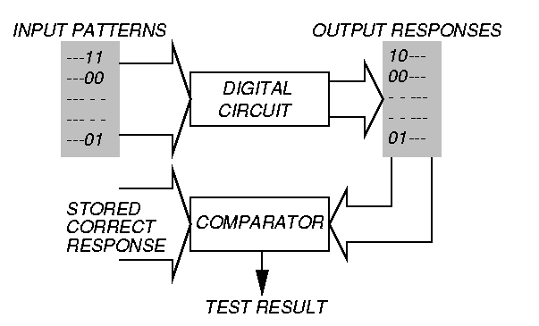
Testing Principle

Slide 15
Verification Testing
Ferociously expensive
May comprise:
  Scanning Electron Microscope tests
  Bright-Lite detection of defects
  Electron beam testing
  Artificial intelligence (expert system) methods
  Repeated functional tests

Slide 16
Characterization Test
Worst-case test
  Choose test that passes/fails chips
  Select statistically significant sample of chips
  Repeat test for every combination of 2+ environmental variables
  Plot results in Shmoo plot
  Diagnose and correct design errors
Continue throughout production life of chips to improve design and process to increase yield

Slide 17
Manufacturing Test
Determines whether manufactured chip meets specs
Must cover high % of modeled faults
Must minimize test time (to control cost)
No fault diagnosis
Tests every device on chip
Test at speed of application or speed guaranteed by supplier

Slide 18
Burn-in or Stress Test
Process:
  Subject chips to high temperature & over-voltage supply, while running production tests
Catches:
  Infant mortality cases – these are damaged chips that will fail in the first 2 days of operation – causes bad devices to actually fail before chips are shipped to customers
  Freak failures – devices having same failure mechanisms as reliable devices

Slide 19
Types of Manufacturing Tests
Wafer sort or probe test – done before wafer is scribed and cut into chips
  Includes test site characterization – specific test devices are checked with specific patterns to measure:
    Gate threshold
    Polysilicon field threshold
    Poly sheet resistance, etc.
Packaged device tests

Slide 20
Sub-types of Tests
Parametric – measures electrical properties of pin electronics – delay, voltages, currents, etc. – fast and cheap
Functional – used to cover very high % of modeled faults – test every transistor and wire in digital circuits – long and expensive – main topic of tutorial

Slide 21
Test Data Analysis
Uses of ATE test data:
  Reject bad DUTS
  Fabrication process information
  Design weakness information
Devices that did not fail are good only if tests covered 100% of faults
Failure mode analysis (FMA)
  Diagnose reasons for device failure, and find design and process weaknesses
  Allows improvement of logic & layout design rules

Slide 22
Test Basics

Slide 23
Test Basics
DUT
f (x1, x2, …xn) fault free function
fa (x1, x2, …xn) when fault is present
x1
x2
x3
.
.
xn
Input (a1, a2, a3 … an) is a test for fault a iff
f (a1, a2, a3 … an) ≠ fa (a1, a2, a3 … an)
Note: We are only interested in knowing if the DUT
is faulty, not in diagnosing or locating the fault
Notes:
View it as a slide show first. It will highlight important aspects of your presentation, and give you an example of a presentation that lives up to ITC presentation standards and guidelines.
Virus checker: When we created this presentation guide it contained no known viruses. This file was checked by McAfee VShield 4.x software before being distributed to authors. You should use a good, up to date virus checker on this file, and any other file you import from an outside source. Make sure your virus checker’s data files are up to date, too. Keep in mind: the version of this file you are reading may be different from the version we checked!
Confidentiality: We respect your copyright, and do not distribute your presentation before the conference. However, we cannot promise strict confidentiality of your presentation before the conference, because others have read access to our FTP sites. Do not include confidential information in your presentation.
Test Slide: A test slide is included as a “hidden slide” after the end of this presentation. If you want to do a trial projection, ensure that your projector projects the entire slide, and that aspect ratios are correct. We will use the same test slide at the conference for setup of our projection equipment.

Slide 24
Test Basics
For an n input circuit, there are 2^{n} input combinations.
Ideally we must test for all possible faulty functions.
This will require an exhaustive test with 2^{n} inputs
x1 x2 x3 f
0 0 0 1
0 0 1 0
0 1 0 0
0 1 1 1
1 0 0 1
1 0 1 1
1 1 0 0
1 1 1 1
Since we cannot apply the exhaustive test set our best bet is to target likely faults!
Notes:
View it as a slide show first. It will highlight important aspects of your presentation, and give you an example of a presentation that lives up to ITC presentation standards and guidelines.
Virus checker: When we created this presentation guide it contained no known viruses. This file was checked by McAfee VShield 4.x software before being distributed to authors. You should use a good, up to date virus checker on this file, and any other file you import from an outside source. Make sure your virus checker’s data files are up to date, too. Keep in mind: the version of this file you are reading may be different from the version we checked!
Confidentiality: We respect your copyright, and do not distribute your presentation before the conference. However, we cannot promise strict confidentiality of your presentation before the conference, because others have read access to our FTP sites. Do not include confidential information in your presentation.
Test Slide: A test slide is included as a “hidden slide” after the end of this presentation. If you want to do a trial projection, ensure that your projector projects the entire slide, and that aspect ratios are correct. We will use the same test slide at the conference for setup of our projection equipment.

Slide 25
Test Basics
Defects Faults and Errors
A Defect is a physical flaw in the device, i.e. a shorted transistor or an open interconnect
A Fault is the logic level manifestation of the Defect, i.e. a line permanently stuck at a low logic level
An Error occurs when a fault causes an incorrect logic value at a functional output
Notes:
View it as a slide show first. It will highlight important aspects of your presentation, and give you an example of a presentation that lives up to ITC presentation standards and guidelines.
Virus checker: When we created this presentation guide it contained no known viruses. This file was checked by McAfee VShield 4.x software before being distributed to authors. You should use a good, up to date virus checker on this file, and any other file you import from an outside source. Make sure your virus checker’s data files are up to date, too. Keep in mind: the version of this file you are reading may be different from the version we checked!
Confidentiality: We respect your copyright, and do not distribute your presentation before the conference. However, we cannot promise strict confidentiality of your presentation before the conference, because others have read access to our FTP sites. Do not include confidential information in your presentation.
Test Slide: A test slide is included as a “hidden slide” after the end of this presentation. If you want to do a trial projection, ensure that your projector projects the entire slide, and that aspect ratios are correct. We will use the same test slide at the conference for setup of our projection equipment.

Slide 26
Test Basics
Likely defects
Depend on the circuit, layout, process control
Difficult to obtain
Simplify the problem by targeting only Logical Faults
Fault Model
Physical Defects Logical Faults
Notes:
View it as a slide show first. It will highlight important aspects of your presentation, and give you an example of a presentation that lives up to ITC presentation standards and guidelines.
Virus checker: When we created this presentation guide it contained no known viruses. This file was checked by McAfee VShield 4.x software before being distributed to authors. You should use a good, up to date virus checker on this file, and any other file you import from an outside source. Make sure your virus checker’s data files are up to date, too. Keep in mind: the version of this file you are reading may be different from the version we checked!
Confidentiality: We respect your copyright, and do not distribute your presentation before the conference. However, we cannot promise strict confidentiality of your presentation before the conference, because others have read access to our FTP sites. Do not include confidential information in your presentation.
Test Slide: A test slide is included as a “hidden slide” after the end of this presentation. If you want to do a trial projection, ensure that your projector projects the entire slide, and that aspect ratios are correct. We will use the same test slide at the conference for setup of our projection equipment.

Slide 27
The Stuck-at Fault Model
Assumes defects cause a signal line to be permanently stuck high or stuck low
s-a-0 Stuck-at 0
s-a-1 Stuck-at 1
How good is this model?
What does it buy us?
Notes:
View it as a slide show first. It will highlight important aspects of your presentation, and give you an example of a presentation that lives up to ITC presentation standards and guidelines.
Virus checker: When we created this presentation guide it contained no known viruses. This file was checked by McAfee VShield 4.x software before being distributed to authors. You should use a good, up to date virus checker on this file, and any other file you import from an outside source. Make sure your virus checker’s data files are up to date, too. Keep in mind: the version of this file you are reading may be different from the version we checked!
Confidentiality: We respect your copyright, and do not distribute your presentation before the conference. However, we cannot promise strict confidentiality of your presentation before the conference, because others have read access to our FTP sites. Do not include confidential information in your presentation.
Test Slide: A test slide is included as a “hidden slide” after the end of this presentation. If you want to do a trial projection, ensure that your projector projects the entire slide, and that aspect ratios are correct. We will use the same test slide at the conference for setup of our projection equipment.

Slide 28
Stuck-at Test for NAND4
Y
A
B
C
D
Fault List:
Possible Faults {A/0, A/1, B/0, B/1, C/0, C/1, D/0, D/1, Y/0, Y/1}
Test Faults Detected
A B C D
1 1 1 1 A/0, B/0, C/0, D/0, Y/1
0 1 1 1 A/1, Y/0
1 0 1 1 B/1, Y/0
1 1 0 1 C/1, Y/0
1 1 1 0 D/1, Y/0
Test Set size = n+1
not 2^{n}
Notes:
View it as a slide show first. It will highlight important aspects of your presentation, and give you an example of a presentation that lives up to ITC presentation standards and guidelines.
Virus checker: When we created this presentation guide it contained no known viruses. This file was checked by McAfee VShield 4.x software before being distributed to authors. You should use a good, up to date virus checker on this file, and any other file you import from an outside source. Make sure your virus checker’s data files are up to date, too. Keep in mind: the version of this file you are reading may be different from the version we checked!
Confidentiality: We respect your copyright, and do not distribute your presentation before the conference. However, we cannot promise strict confidentiality of your presentation before the conference, because others have read access to our FTP sites. Do not include confidential information in your presentation.
Test Slide: A test slide is included as a “hidden slide” after the end of this presentation. If you want to do a trial projection, ensure that your projector projects the entire slide, and that aspect ratios are correct. We will use the same test slide at the conference for setup of our projection equipment.

Slide 29
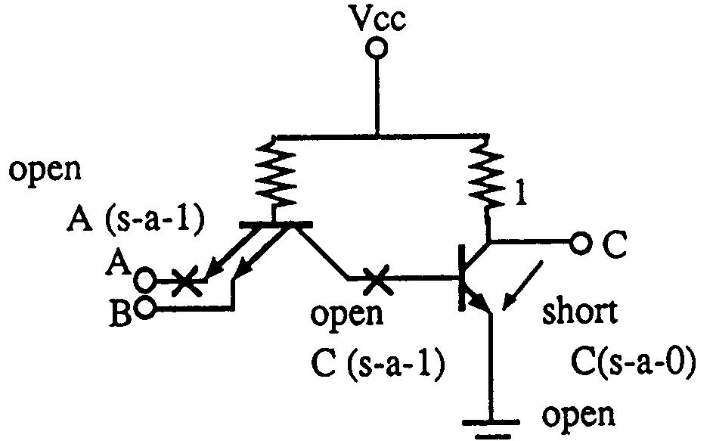
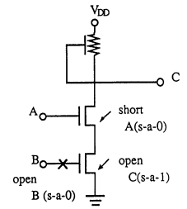
Stuck-at-fault Model
Was reasonable for Bipolar
technologies and NMOS
Less good for CMOS
Notes:
View it as a slide show first. It will highlight important aspects of your presentation, and give you an example of a presentation that lives up to ITC presentation standards and guidelines.
Virus checker: When we created this presentation guide it contained no known viruses. This file was checked by McAfee VShield 4.x software before being distributed to authors. You should use a good, up to date virus checker on this file, and any other file you import from an outside source. Make sure your virus checker’s data files are up to date, too. Keep in mind: the version of this file you are reading may be different from the version we checked!
Confidentiality: We respect your copyright, and do not distribute your presentation before the conference. However, we cannot promise strict confidentiality of your presentation before the conference, because others have read access to our FTP sites. Do not include confidential information in your presentation.
Test Slide: A test slide is included as a “hidden slide” after the end of this presentation. If you want to do a trial projection, ensure that your projector projects the entire slide, and that aspect ratios are correct. We will use the same test slide at the conference for setup of our projection equipment.

Slide 30
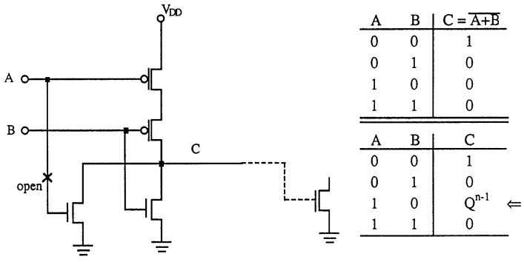
CMOS Stuck-open
A combinational circuit can become sequential
Notes:
View it as a slide show first. It will highlight important aspects of your presentation, and give you an example of a presentation that lives up to ITC presentation standards and guidelines.
Virus checker: When we created this presentation guide it contained no known viruses. This file was checked by McAfee VShield 4.x software before being distributed to authors. You should use a good, up to date virus checker on this file, and any other file you import from an outside source. Make sure your virus checker’s data files are up to date, too. Keep in mind: the version of this file you are reading may be different from the version we checked!
Confidentiality: We respect your copyright, and do not distribute your presentation before the conference. However, we cannot promise strict confidentiality of your presentation before the conference, because others have read access to our FTP sites. Do not include confidential information in your presentation.
Test Slide: A test slide is included as a “hidden slide” after the end of this presentation. If you want to do a trial projection, ensure that your projector projects the entire slide, and that aspect ratios are correct. We will use the same test slide at the conference for setup of our projection equipment.

Slide 31
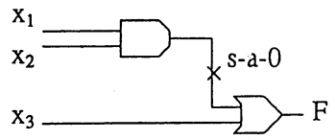
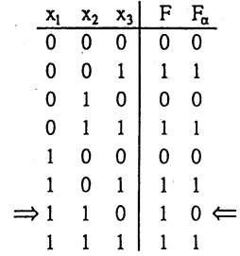
Test Generation for Combinational Circuits
Conceptually simple:
Derive a truth table for the fault free circuit
Derive a truth table for the faulty circuit
Select a row with differing outputs
Notes:
View it as a slide show first. It will highlight important aspects of your presentation, and give you an example of a presentation that lives up to ITC presentation standards and guidelines.
Virus checker: When we created this presentation guide it contained no known viruses. This file was checked by McAfee VShield 4.x software before being distributed to authors. You should use a good, up to date virus checker on this file, and any other file you import from an outside source. Make sure your virus checker’s data files are up to date, too. Keep in mind: the version of this file you are reading may be different from the version we checked!
Confidentiality: We respect your copyright, and do not distribute your presentation before the conference. However, we cannot promise strict confidentiality of your presentation before the conference, because others have read access to our FTP sites. Do not include confidential information in your presentation.
Test Slide: A test slide is included as a “hidden slide” after the end of this presentation. If you want to do a trial projection, ensure that your projector projects the entire slide, and that aspect ratios are correct. We will use the same test slide at the conference for setup of our projection equipment.

Slide 32
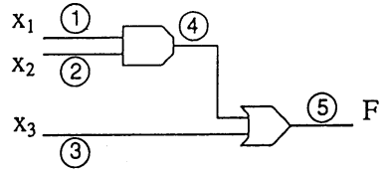
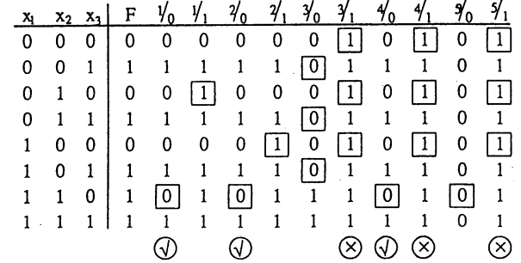
Generating a Test Set
Essential Tests {010, 100, 110}
Minimal Test Set (not unique)
{010, 100, 110, 001}
Notes:
View it as a slide show first. It will highlight important aspects of your presentation, and give you an example of a presentation that lives up to ITC presentation standards and guidelines.
Virus checker: When we created this presentation guide it contained no known viruses. This file was checked by McAfee VShield 4.x software before being distributed to authors. You should use a good, up to date virus checker on this file, and any other file you import from an outside source. Make sure your virus checker’s data files are up to date, too. Keep in mind: the version of this file you are reading may be different from the version we checked!
Confidentiality: We respect your copyright, and do not distribute your presentation before the conference. However, we cannot promise strict confidentiality of your presentation before the conference, because others have read access to our FTP sites. Do not include confidential information in your presentation.
Test Slide: A test slide is included as a “hidden slide” after the end of this presentation. If you want to do a trial projection, ensure that your projector projects the entire slide, and that aspect ratios are correct. We will use the same test slide at the conference for setup of our projection equipment.

Slide 33
Generating a Test Set
Such a tabular method is completely impractical because of the exponential growth in table size with number of inputs
Picking a minimal complete test set from such a table is also a NP Complete problem
We use the circuit structure to generate the test set in practice
Notes:
View it as a slide show first. It will highlight important aspects of your presentation, and give you an example of a presentation that lives up to ITC presentation standards and guidelines.
Virus checker: When we created this presentation guide it contained no known viruses. This file was checked by McAfee VShield 4.x software before being distributed to authors. You should use a good, up to date virus checker on this file, and any other file you import from an outside source. Make sure your virus checker’s data files are up to date, too. Keep in mind: the version of this file you are reading may be different from the version we checked!
Confidentiality: We respect your copyright, and do not distribute your presentation before the conference. However, we cannot promise strict confidentiality of your presentation before the conference, because others have read access to our FTP sites. Do not include confidential information in your presentation.
Test Slide: A test slide is included as a “hidden slide” after the end of this presentation. If you want to do a trial projection, ensure that your projector projects the entire slide, and that aspect ratios are correct. We will use the same test slide at the conference for setup of our projection equipment.

Slide 34
Stuck-at Faults

Slide 35
Single Stuck-at Fault
Three properties define a single stuck-at fault
    Only one line is faulty
    The faulty line is permanently set to 0 or 1
    The fault can be at an input or output of a gate
Example: XOR circuit has 12 fault sites ( ● ) and 24 single stuck-at faults
Faulty circuit value
s-a-0
Good circuit value
c
j
0(1)
a
d
1(0)
1
g
h
z
z
0
i
e
1
b
1
f
k
Test vector for h s-a-0 fault

Slide 36
Fault Collapsing
Number of fault sites in a Boolean gate circuit
N = #PI + #gates + # (fanout branches)
Number of faults to be tested is 2N (Size of the initial fault list)
Fault collapsing attempts to reduce the size of the fault list such than any test set that tests for all faults on this collapsed fault list will also test for all 2N faults in the circuit
Fault collapsing exploits fault equivalence and fault dominance

Slide 37
Fault Equivalence
Fault equivalence: Two faults f1 and f2 are equivalent if all tests that detect f1 also detect f2.
If faults f1 and f2 are equivalent then the corresponding faulty functions are identical.
Equivalence collapsing: All single faults of a logic circuit can be divided into disjoint equivalence subsets, where all faults in a subset are mutually equivalent. A collapsed fault set contains one fault from each equivalence subset.

Slide 38
Equivalence Rules
sa0
sa0
sa1
sa1
sa0 sa1
sa0 sa1
WIRE
sa0 sa1
sa0 sa1
AND
OR
sa0 sa1
sa0 sa1
sa0
sa1
NOT
sa0
sa1
sa0 sa1
sa0 sa1
sa0 sa1
sa0 sa1
sa0
NAND
NOR
sa1
sa0 sa1
sa0
sa0 sa1
sa1
sa0
FANOUT
sa1

Slide 39
Fault Dominance
If all tests of some fault F1 detect another fault F2, then F2 is said to dominate F1.
Dominance collapsing: If fault F2 dominates F1, then F2 is removed from the fault list.
When dominance fault collapsing is used, it is sufficient to consider only the input faults of Boolean gates. See the next example.

Slide 40
Dominance Example
All tests of F2
F1
s-a-1
001
110 010
000
101
100
F2
F2
s-a-1
s-a-1
011
s-a-1
Only test of F1
s-a-1
s-a-1
s-a-0
A dominance collapsed fault set

Slide 41
Checkpoints
Primary inputs and fanout branches of a combinational circuit are called checkpoints.
Checkpoint theorem: A test set that detects all single (multiple) stuck-at faults on all checkpoints of a combinational circuit, also detects all single (multiple) stuck-at faults in that circuit.
Total fault sites = 16
Checkpoints ( ● ) = 10

Slide 42
Multiple Stuck-at Faults
A multiple stuck-at fault means that any set of lines is stuck-at some combination of (0,1) values.
The total number of single and multiple stuck-at faults in a circuit with k single fault sites is 3^{k}-1.
A single fault test can fail to detect the target fault if another fault is also present, however, such masking of one fault by another is rare.
Statistically, single fault tests cover a very large number of multiple faults.

Slide 43
Summary
Fault models are analyzable approximations of defects and are essential for a test methodology.
For digital logic single stuck-at fault model offers best advantage of tools and experience.
Many other faults (bridging, stuck-open and multiple stuck-at) are largely covered by stuck-at fault tests.
Stuck-short and delay faults and technology-dependent faults require special tests.
Memory and analog circuits need other specialized fault models and tests.

Slide 44
Simulation
What is simulation?
Design verification
Circuit modeling
True-value simulation algorithms
    Compiled-code simulation
    Event-driven simulation
Summary

Slide 45
Simulation Defined
Definition: Simulation refers to modeling of a design, its function and performance.
A software simulator is a computer program; an emulator is a hardware simulator.
Simulation is used for design verification:
    Validate assumptions
    Verify logic
    Verify performance (timing)
Types of simulation:
    Logic or switch level
    Timing
    Circuit
    Fault

Slide 46
Simulation for Verification
Specification
Synthesis
Response
analysis
Design
changes
Design
(netlist)
Computed
responses
True-value
simulation
Input stimuli

Slide 47
Modeling for Simulation
Modules, blocks or components described by
    Input/output (I/O) function
    Delays associated with I/O signals
    Examples: binary adder, Boolean gates, FET, resistors and capacitors
Interconnects represent
    ideal signal carriers, or
    ideal electrical conductors
Netlist: a format (or language) that describes a design as an interconnection of modules. Netlist may use hierarchy.

Slide 48
Example: A Full-Adder
c
HA;
inputs: a, b;
outputs: c, f;
AND: A1, (a, b), (c);
AND: A2, (d, e), (f);
OR: O1, (a, b), (d);
NOT: N1, (c), (e);
a
e
d
f
b
HA
Half-adder
A
D
Carry
FA;
inputs: A, B, C;
outputs: Carry, Sum;
HA: HA1, (A, B), (D, E);
HA: HA2, (E, C), (F, Sum);
OR: O2, (D, F), (Carry);
HA1
E
F
B
HA2
Sum
C
Full-adder

Slide 49
Logic Model of MOS Circuit
V_{DD}
pMOS FETs
a
D_{a}
a
D_{c}
c
C_{a}
b
D_{b}
c
C_{c}
b
D_{a} and D_{b} are
interconnect or
propagation delays
D_{c} is inertial delay
of gate
C_{b}
nMOS FETs
C_{a} , C_{b} and C_{c} are
parasitic capacitances

Slide 50
Options for Inertial Delay
(simulation of a NAND gate)
Transient
region
a
Inputs
b
c (CMOS)
c (zero delay)
c (unit delay)
Logic simulation
X
rise=5, fall=5
c (multiple delay)
Unknown (X)
c (minmax delay)
min =2, max =5
0
5
Time units

Slide 51
Signal States
Two-states (0, 1) can be used for purely combinational logic with zero-delay.
Three-states (0, 1, X) are essential for timing hazards and for sequential logic initialization.
Four-states (0, 1, X, Z) are essential for MOS devices. See example below.
Analog signals are used for exact timing of digital logic and for analog circuits.
Z
(hold previous value)
0
0

Slide 52
Modeling Levels
Modeling
level
Function,
behavior, RTL
Logic
Switch
Timing
Circuit
Circuit
description
Programming
language-like HDL
Connectivity of
Boolean gates,
flip-flops and
transistors
Transistor size
and connectivity,
node capacitances
Transistor technology
data, connectivity,
node capacitances
Tech. Data, active/
passive component
connectivity
Signal
values
0, 1
0, 1, X
and Z
0, 1
and X
Analog
voltage
Analog
voltage,
current
Timing
Clock
boundary
Zero-delay
unit-delay,
multiple-
delay
Zero-delay
Fine-grain
timing
Continuous
time
Application
Architectural
and functional
verification
Logic
verification
and test
Logic
verification
Timing
verification
Digital timing
and analog
circuit
verification

Slide 53
True-Value Simulation Algorithms
Compiled-code simulation
    Applicable to zero-delay combinational logic
    Also used for cycle-accurate synchronous sequential circuits for logic verification
    Efficient for highly active circuits, but inefficient for low-activity circuits
    High-level (e.g., C language) models can be used
Event-driven simulation
    Only gates or modules with input events are evaluated (event means a signal change)
    Delays can be accurately simulated for timing verification
    Efficient for low-activity circuits
    Can be extended for fault simulation

Slide 54
Compiled-Code Algorithm
Step 1: Levelize combinational logic and encode in a compilable programming language
Step 2: Initialize internal state variables (flip-flops)
Step 3: For each input vector
  Set primary input variables
  Repeat (until steady-state or max. iterations)
    Execute compiled code
  Report or save computed variables

Slide 55
Event-Driven Algorithm
(Example)
Scheduled
events
c = 0
d = 1, e = 0
g = 0
f = 1
g = 1
Activity
list
d, e
f, g
g
a =1
e =1
2
t = 0
1
2
3
4
5
6
7
8
c =1 0
g =1
2
2
d = 0
4
f =0
b =1
Time stack
g
0
4
8
Time, t

Slide 56
Efficiency of Event-Driven Simulator
Simulates events (value changes) only
Speed up over compiled-code can be ten times or more; in large logic circuits about 0.1 to 10% gates become active for an input change
Steady 0
0 → 1 event
Large logic
block without
activity
Steady 0
(no event)

Slide 57
Summary
Logic or true-value simulators are essential tools for design verification.
Verification vectors and expected responses are generated (often manually) from specifications.
A logic simulator can be implemented using either compiled-code or event-driven method.
Per vector complexity of a logic simulator is approximately linear in circuit size.
Modeling level determines the evaluation procedures used in the simulator.

Slide 58
Fault Simulation
Problem and motivation
Fault simulation algorithms
    Serial
    Parallel
    Concurrent
Random Fault Sampling
Summary

Slide 59
Problem and Motivation
Fault simulation Problem:
Given
    A circuit
    A sequence of test vectors
    A fault model
Determine
    Fault coverage - fraction (or percentage) of modeled faults detected by test vectors
    Set of undetected faults
Motivation
    Determine test quality and in turn product quality
    Find undetected fault targets to improve tests

Slide 60
Fault simulator in a VLSI Design Process
Verified design
netlist
Verification
input stimuli
Fault simulator
Test vectors
Modeled
fault list
Remove
tested faults
Test
compactor
Delete
vectors
Fault
coverage
?
Low
Test
generator
Add vectors
Adequate
Stop

Slide 61
Fault Simulation Scenario
Circuit model: mixed-level
    Mostly logic with some switch-level for high-impedance (Z) and bidirectional signals
    High-level models (memory, etc.) with pin faults
Signal states: logic
    Two (0, 1) or three (0, 1, X) states for purely Boolean logic circuits
    Four states (0, 1, X, Z) for sequential MOS circuits
Timing:
    Zero-delay for combinational and synchronous circuits
    Mostly unit-delay for circuits with feedback

Slide 62
Fault Simulation Scenario (Continued)
Faults:
    Mostly single stuck-at faults
    Sometimes stuck-open, transition, and path-delay faults; analog circuit fault simulators are not yet in common use
    Equivalence fault collapsing of single stuck-at faults
    Fault-dropping -- a fault once detected is dropped from consideration as more vectors are simulated; fault-dropping may be suppressed for diagnosis
    Fault sampling -- a random sample of faults is simulated when the circuit is large

Slide 63
Fault Simulation Algorithms
Serial
Parallel
Deductive*
Concurrent
Differential*
* Not discussed; see M. L. Bushnell and V. D. Agrawal,
Essentials of Electronic Testing for Digital, Memory
and Mixed-Signal VLSI Circuits, Springer, 2000,
Chapter 5.

Slide 64
Serial Algorithm
Algorithm: Simulate fault-free circuit and save responses. Repeat following steps for each fault in the fault list:
    Modify netlist by injecting one fault
    Simulate modified netlist, vector by vector, comparing responses with saved responses
    If response differs, report fault detection and suspend simulation of remaining vectors
Advantages:
    Easy to implement; needs only a true-value simulator, less memory
    Most faults, including analog faults, can be simulated

Slide 65
Serial Algorithm (Cont.)
Disadvantage: Much repeated computation; CPU time prohibitive for VLSI circuits
Alternative: Simulate many faults together
Test vectors
Fault-free circuit
Comparator
f1 detected?
Circuit with fault f1
Comparator
f2 detected?
Circuit with fault f2
Comparator
fn detected?
Circuit with fault fn

Slide 66
Parallel Fault Simulation
Compiled-code method; best with two-states (0,1)
Exploits inherent bit-parallelism of logic operations on computer words
Storage: one word per line for two-state simulation
Multi-pass simulation: Each pass simulates w-1 new faults, where w is the machine word length
Speed up over serial method ~ w-1
Not suitable for circuits with timing-critical and non-Boolean logic

Slide 67
Parallel Fault Sim. Example
Bit 0: fault-free circuit
Bit 1: circuit with c s-a-0
Bit 2: circuit with f s-a-1
1 1 1
c s-a-0 detected
a
1 0 1
1 1 1
1 0 1
b
e
c
1 0 1
s-a-0
g
0 0 0
d
f
s-a-1
0 0 1

Slide 68
Concurrent Fault Simulation
Event-driven simulation of fault-free circuit and only those parts of the faulty circuit that differ in signal states from the fault-free circuit.
A list per gate containing copies of the gate from all faulty circuits in which this gate differs. List element contains fault ID, gate input and output values and internal states, if any.
All events of fault-free and all faulty circuits are implicitly simulated.
Faults can be simulated in any modeling style or detail supported in true-value simulation (offers most flexibility.)
Faster than other methods, but uses most memory.

Slide 69
Conc. Fault Sim. Example
a₀
b₀
c₀
e₀
0
1
1
1
0
0
0
0
1
0
0
1
1
a
1
1
1
1
e
b
1
1
1
c
g
1
0
0
1
0
a₀
b₀
c₀
e₀
d
f
0
0
0
0
0
1
0
0
0
1
0
0
1
1
1
b₀
d₀
f₁
0
1
1
0
g₀
1
f₁
1
d₀
0
1
0
1
1
1

Slide 70
Fault Sampling
A randomly selected subset (sample) of faults is simulated.
Measured coverage in the sample is used to estimate fault coverage in the entire circuit.
Advantage: Saving in computing resources (CPU time and memory.)
Disadvantage: Limited data on undetected faults.
In practice, if a set of few thousand faults is randomly selected, the simulation gives a reasonably accurate estimate of the true fault coverage, irrespective of the circuit size.

Slide 71
Motivation for Sampling
Complexity of fault simulation depends on:
    Number of gates
    Number of faults
    Number of vectors
Complexity of fault simulation with fault sampling depends on:
    Number of gates
    Number of vectors

Slide 72
Random Sampling Model
Detected
fault
Undetected
fault
All faults with
a fixed but
unknown
coverage
Random
picking
N_{p} = total number of faults
(population size)
C = fault coverage (unknown)
N_{s} = sample size
N_{s} << N_{p}
c = sample coverage
(a random variable)

Slide 73
Probability Density of Sample Coverage, c
(x ─ C )²
─ ─────
1 2σ ²
p (x ) = Prob(x ≤ c ≤ x +dx ) = ─────── e
σ (2 π) ^{1/2}
C (1 ─ C)
Variance, σ ² = ──────
N_{s}
σ
σ
Sampling
error
p (x )
Mean = C
x
C -3σ
C
x
C +3σ
1.0
Sample coverage

Slide 74
Sampling Error Bounds
C (1 - C )
| x - C | = 3 [ ─────── ] ^{1/2}
N_{s}
Solving the quadratic equation for C, we get the 3-sigma
(99.7% confidence) estimate:
4.5
C _{3σ} = x ± ─── [1 + 0.44 N_{s} x (1 ─ x )]^{1/2}
N_{s}
Where N_{s} is sample size and x is the measured fault coverage in the sample.
Example: A circuit with 39,096 faults has an actual fault coverage of 87.1%. The measured coverage in a random sample of 1,000 faults is 88.7%. The above formula gives an estimate of 88.7% ± 3%. CPU time for sample simulation was about 10% of that for all faults.

Slide 75
Summary
Fault simulator is an essential tool for test development.
Concurrent fault simulation algorithm offers the best choice.
For restricted class of circuits (combinational or synchronous sequential and with only Boolean primitives), differential algorithm can provide better speed and memory efficiency.
For large circuits, the accuracy of random fault sampling only depends on the sample size (1,000 to 2,000 faults) and not on the circuit size. The method has significant advantages in reducing CPU time and memory needs of the simulator.

Slide 76
Testability Measures
Definition
Controllability and observability
SCOAP measures
  Combinational circuits
  Sequential circuits
Summary

Slide 77
What are Testability Measures?
Approximate measures of:
  Difficulty of setting internal circuit lines to 0 or 1 from primary inputs.
  Difficulty of observing internal circuit lines at primary outputs.
Applications:
  Analysis of difficulty of testing internal circuit parts – redesign or add special test hardware.
  Guidance for algorithms computing test patterns – avoid using hard-to-control lines.

Slide 78
Testability Analysis
Determines testability measures
Involves Circuit Topological analysis, but no
test vectors (static analysis) and no search algorithm.
Linear computational complexity
  Otherwise, analysis is pointless – might as well use
  automatic test-pattern generation and
  calculate:
    Exact fault coverage
    Exact test vectors

Slide 79
SCOAP Measures
SCOAP – Sandia Controllability and Observability Analysis Program
Combinational measures:
  CC0 – Difficulty of setting circuit line to logic 0
  CC1 – Difficulty of setting circuit line to logic 1
  CO – Difficulty of observing a circuit line
Sequential measures – analogous:
  SC0
  SC1
  SO
Ref.: L. H. Goldstein, “Controllability/Observability Analysis of Digital Circuits,” IEEE Trans. CAS, vol. CAS-26, no. 9. pp. 685 – 693, Sep. 1979.

Slide 80
Range of SCOAP Measures
Controllabilities – 1 (easiest) to infinity (hardest)
Observabilities – 0 (easiest) to infinity (hardest)
Combinational measures:
  Roughly proportional to number of circuit lines that must be set to control or observe given line.
Sequential measures:
  Roughly proportional to number of times flip-flops must be clocked to control or observe given line.

Slide 81
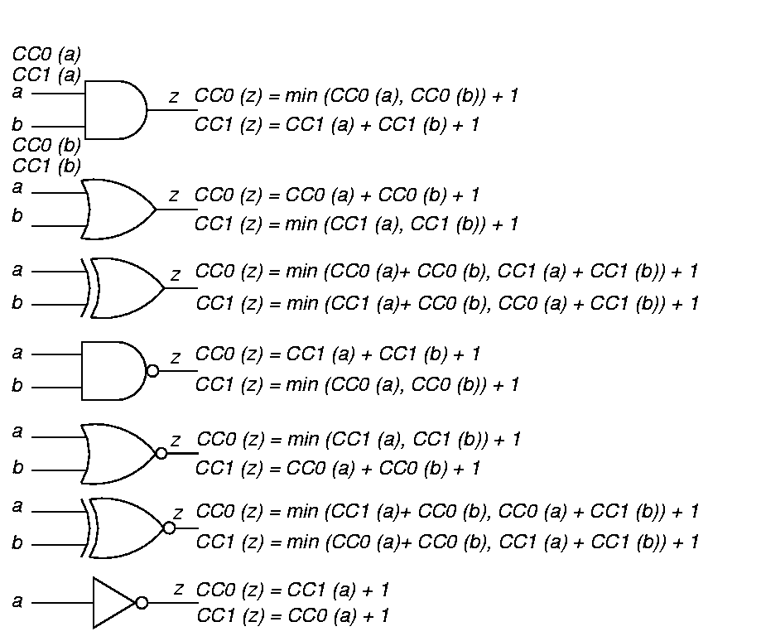
Combinational Controllability

Slide 82
Controllability Formulas
(Continued)

Slide 83
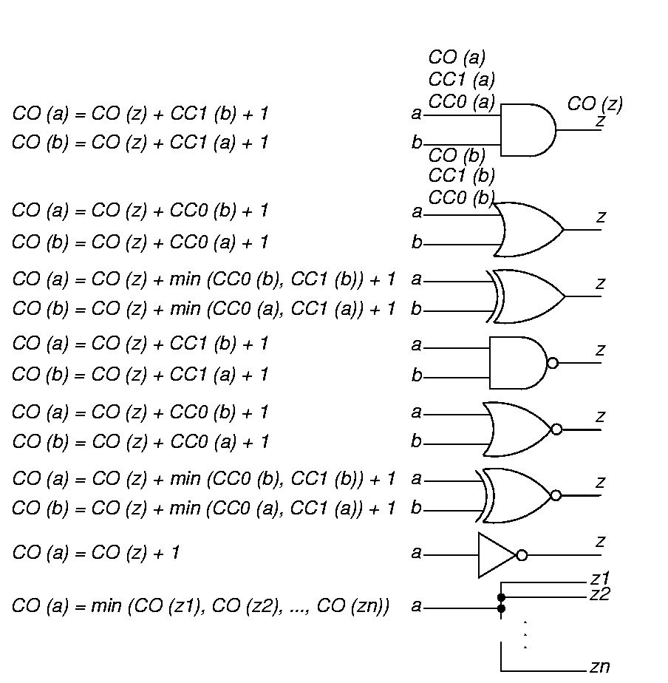
Combinational Observability
To observe a gate input: Observe output and make other input values non-controlling.

Slide 84
Observability Formulas
(Continued)
Fanout stem: Observe through branch with best observability.

Slide 85
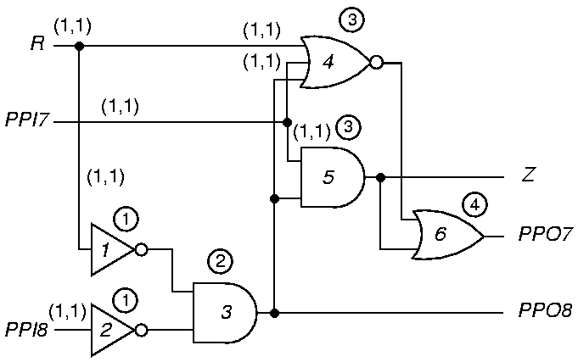
Comb. Controllability
Circled numbers give level number. (CC0, CC1)

Slide 86
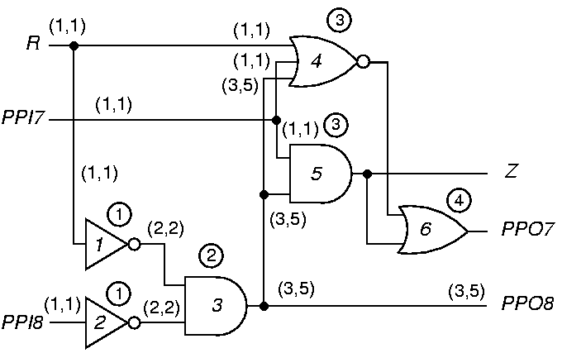
Controllability Through Level 2

Slide 87
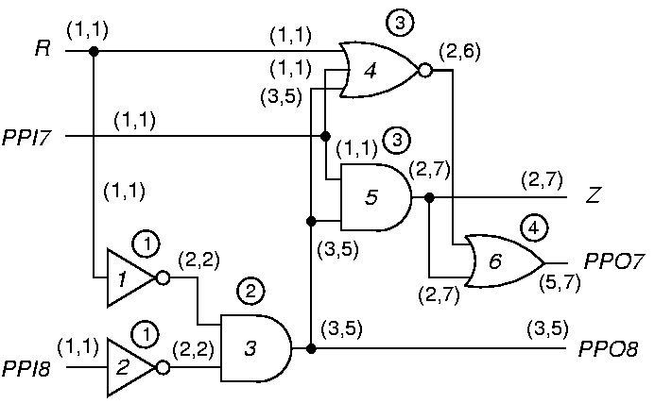
Final Combinational Controllability

Slide 88
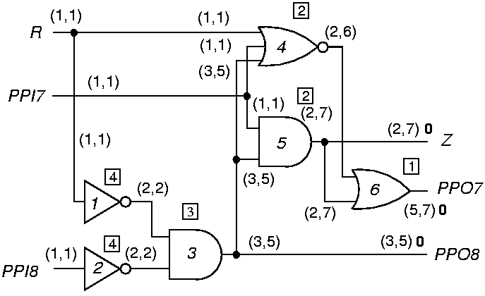
Combinational Observability for Level 1
Number in square box is level from primary outputs (POs).
(CC0, CC1) CO

Slide 89
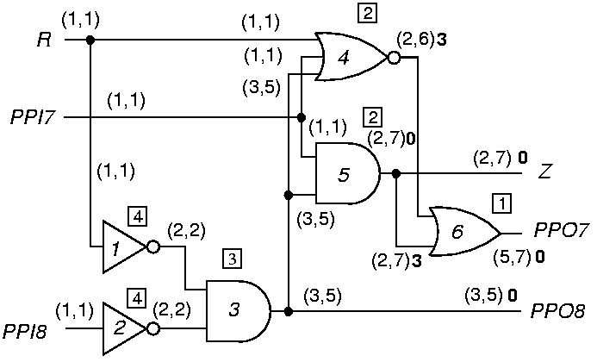
Combinational Observabilities for Level 2

Slide 90
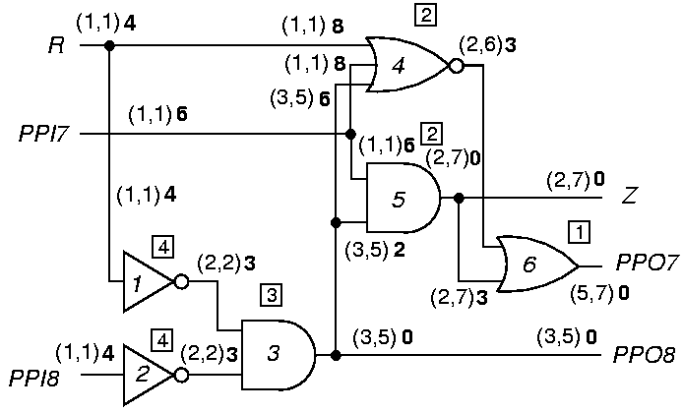
Final Combinational Observabilities

Slide 91
Sequential Measures (Comparison)
Combinational
  Increment CC0, CC1, CO whenever you pass through a gate, either forward or backward.
Sequential
  Increment SC0, SC1, SO only when you pass through a flip-flop, either forward or backward.
Both
  Must iterate on feedback loops until controllabilities stabilize.

Slide 92
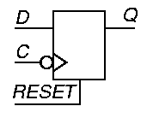
D Flip-Flop Equations
Assume a synchronous RESET line.
CC1 (Q) = CC1 (D) + CC1 (C) + CC0 (C) + CC0
(RESET)
SC1 (Q) = SC1 (D) + SC1 (C) + SC0 (C) + SC0
(RESET) + 1
CC0 (Q) = min [CC1 (RESET) + CC1 (C) + CC0 (C),
CC0 (D) + CC1 (C) + CC0 (C)]
SC0 (Q) is analogous
CO (D) = CO (Q) + CC1 (C) + CC0 (C) + CC0
(RESET)
SO (D) is analogous

Slide 93
D Flip-Flop Clock and Reset
CO (RESET) = CO (Q) + CC1 (Q) + CC1 (RESET) +
CC1 (C) + CC0 (C)
SO (RESET) is analogous
Three ways to observe the clock line:
  Set Q to 1 and clock in a 0 from D
  Set the flip-flop and then reset it
  Reset the flip-flop and clock in a 1 from D
CO (C) = min [ CO (Q) + CC1 (Q) + CC0 (D) +
CC1 (C) + CC0 (C),
CO (Q) + CC1 (Q) + CC1 (RESET) +
CC1 (C) + CC0 (C),
CO (Q) + CC0 (Q) + CC0 (RESET) +
CC1 (D) + CC1 (C) + CC0 (C)]
SO (C) is analogous

Slide 94
Testability Computation
For all PIs, CC0 = CC1 = 1 and SC0 = SC1 = 0
For all other nodes, CC0 = CC1 = SC0 = SC1 = ∞
Go from PIs to POs, using CC and SC equations to get controllabilities -- Iterate on loops until SC stabilizes -- convergence is guaranteed.
Set CO = SO = 0 for POs, ∞ for all other lines.
Work from POs to PIs, Use CO, SO, and controllabilities to get observabilities.
Fanout stem (CO, SO) = min branch (CO, SO)
If a CC or SC (CO or SO) is ∞ , that node is uncontrollable (unobservable).

Slide 95
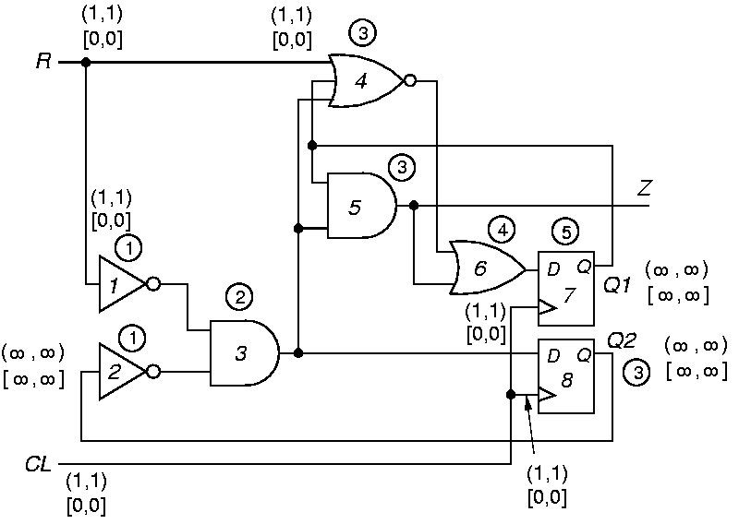
Sequential Example Initialization

Slide 96
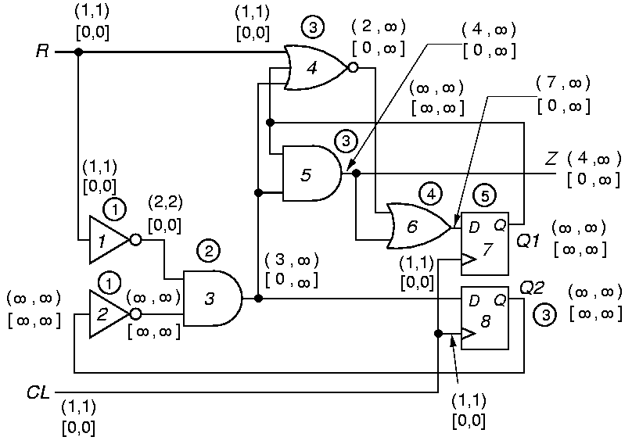
After 1 Iteration

Slide 97
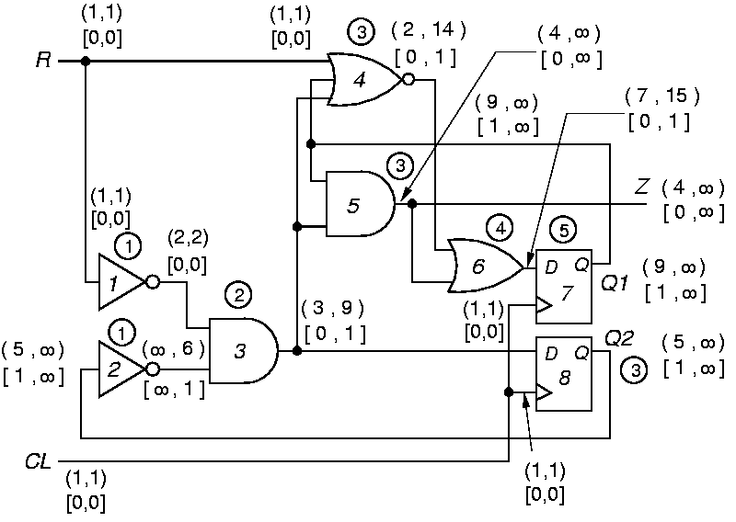
After 2 Iterations

Slide 98
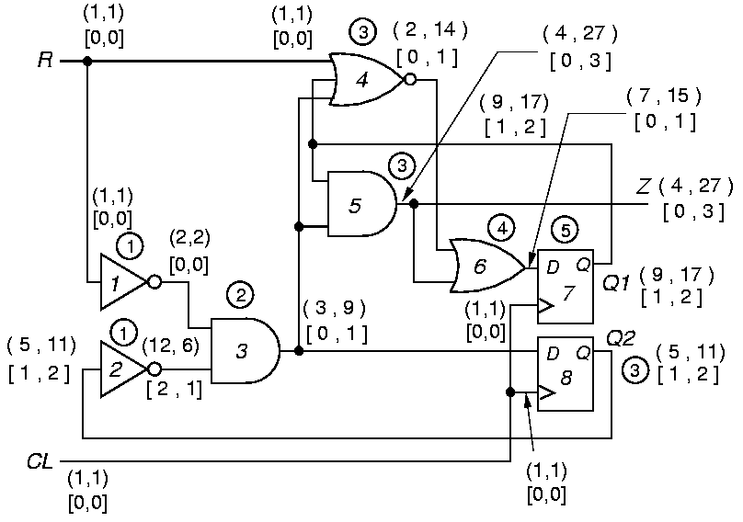
After 3 Iterations

Slide 99

Stable Sequential Measures

Slide 100
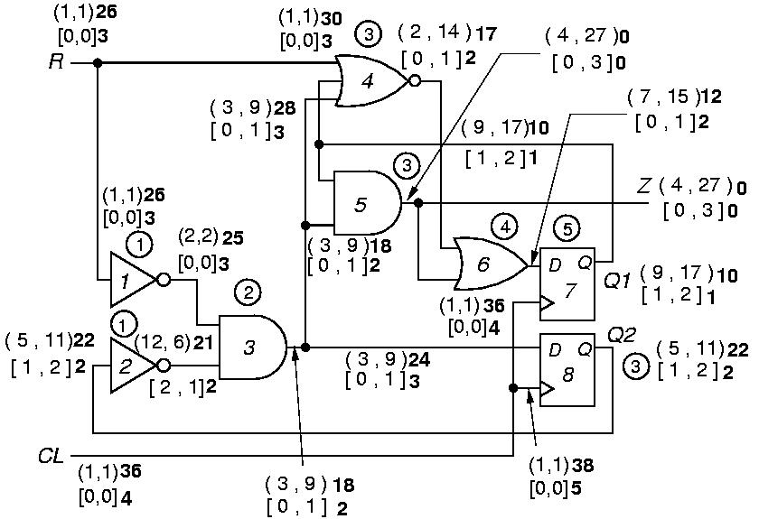
Final Sequential Observabilities

Slide 101
Summary
Testability measures are approximate measures of:
  Difficulty of setting circuit lines to 0 or 1
  Difficulty of observing internal circuit lines
Applications:
  Analysis of difficulty of testing internal circuit parts
    Redesign circuit hardware or add special test hardware where measures show poor controllability or observability.
  Guidance for algorithms computing test patterns – avoid using hard-to-control lines

Slide 102
Exercise 1
What is the total number of single stuck-at faults, counting both stuck-at-0 and stuck-at-1, in the following circuit?

Slide 103
Exercise 1 Answer
Counting two faults on each line,
Total number of faults = 2 × (#PI + #gates + #fanout branches)
= 2 × (2 + 2 + 2) = 12
s-a-0 s-a-1
s-a-0 s-a-1
s-a-0 s-a-1
s-a-0 s-a-1
s-a-0 s-a-1
s-a-0 s-a-1

Slide 104
Exercise 2
For the circuit shown above
    Using the parallel fault simulation algorithm, determine which of the four primary input faults are detectable by the test 00.

Slide 105
Exercise 2: Answer
■ Parallel fault simulation of four PI faults is illustrated below.
Fault PI2 s-a-1 is detected by the 00 test input.
0 0 1 0 0
0 0 0 0 0
PI1=0
0 0 0 0 1
0 0 0 0 1
PI2=0
0 0 0 0 1
No fault
PI1 s-a-0
PI1 s-a-1
PI2 s-a-0
PI2 s-a-1
0 0 0 0 1
PI2 s-a-1 detected

Slide 106
Exercise 3
For the circuit shown above
    Determine SCOAP testability measures.
    Using the sum of controllability and observability as a measure of testability, list the most difficult to test faults.

Slide 107
Exercise 3: Answer
■ SCOAP testability measures, (CC0, CC1) CO, are shown below:
s-a-0
s-a-1
(1,1) 4
(2,3) 2
(1,1) 4
(4,2) 0
s-a-0
(1,1) 3
(1,1) 3
s-a-0
s-a-1
Five faults, shown in the figure, have the highest testability measure of 5.

